Slide 1
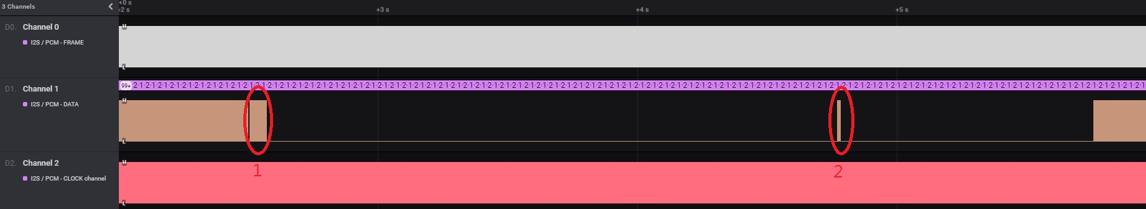
Channel Zapping Noise Test
We streams CH0 (500HZ tone) and Ch2 (1K HZ tone). And do channel zapping from CH0(500hz) to CH2(1K HZ).
We see two places that may cause noise:
CH0: 500HZ tone audio
CH2: 1KHZ tone audio

Slide 2
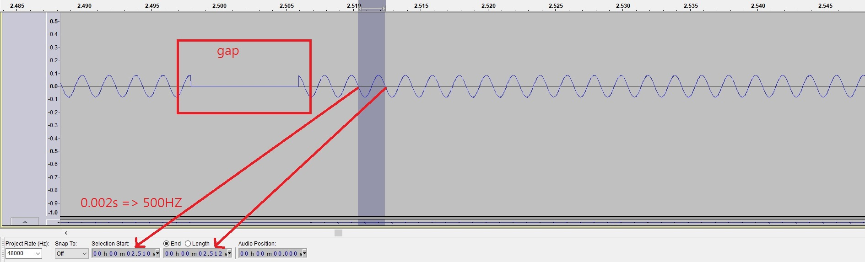
Red Circle 1
Before gap and after gap, the audios are 500HZ.
So, it belong to Ch0. IPTV Player stop causes this gap.

Slide 3
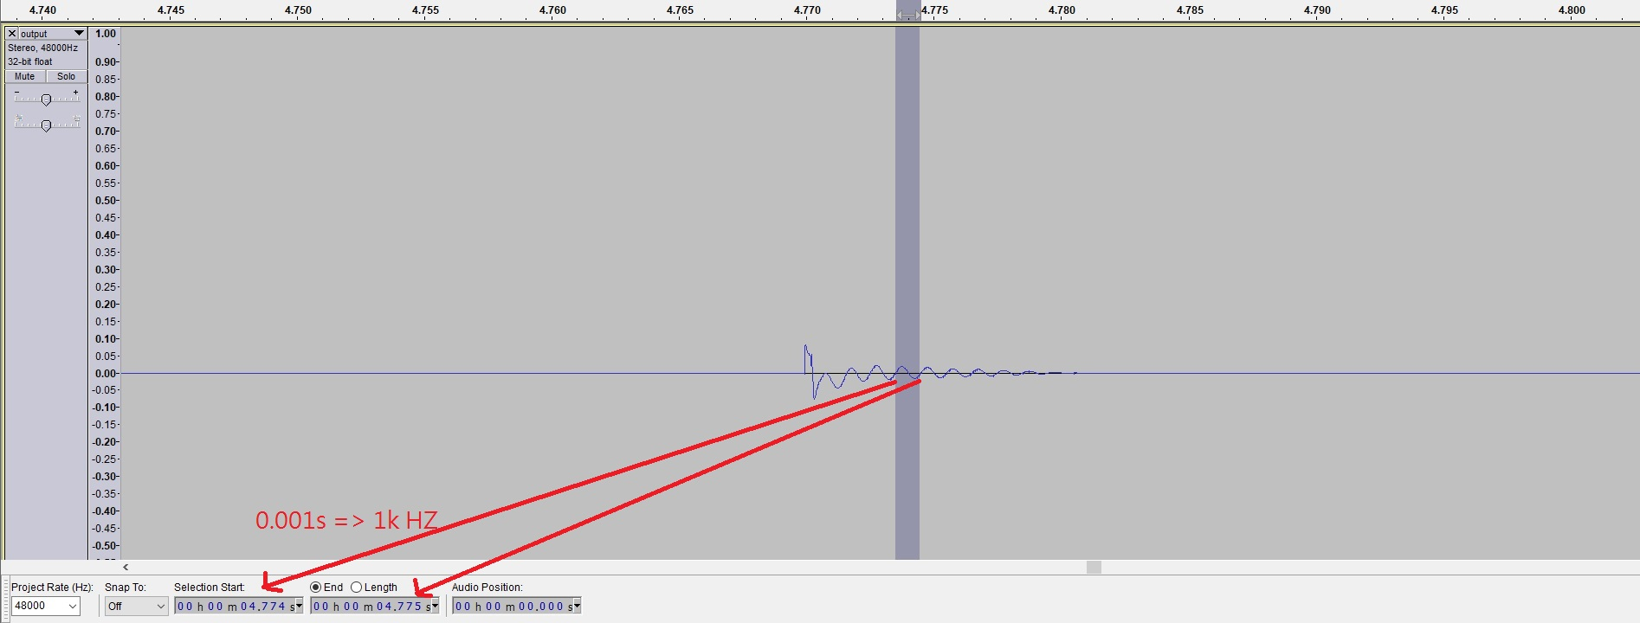
Red Circle 2
This is also 1Khz(Ch2)
The red circle 2 is 1Khz. So it belongs
to Ch2(1KHz).IPTV starts cause this noise.

Slide 4
Conclusion
We think that IPTV player causes noise when IPTV player stop and start.
The problem may be caused by APIs that Synaptics provides to IPTV player to do player stop and play.

